Slide 1
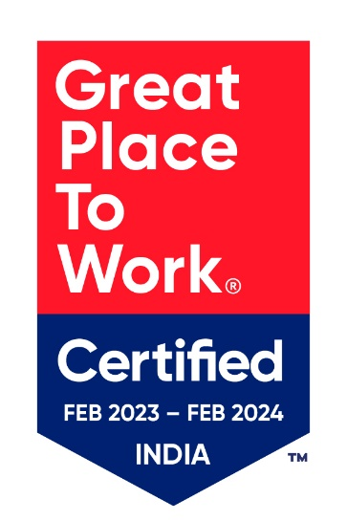

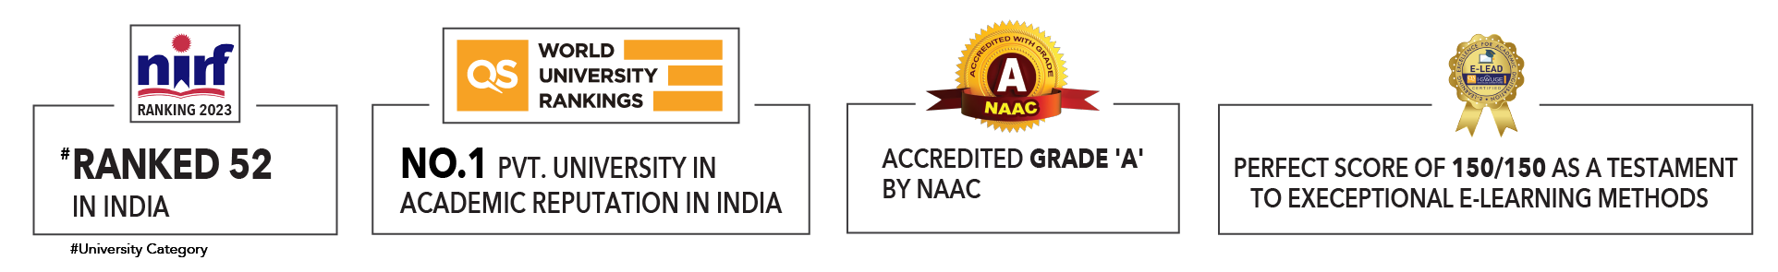

Slide 2
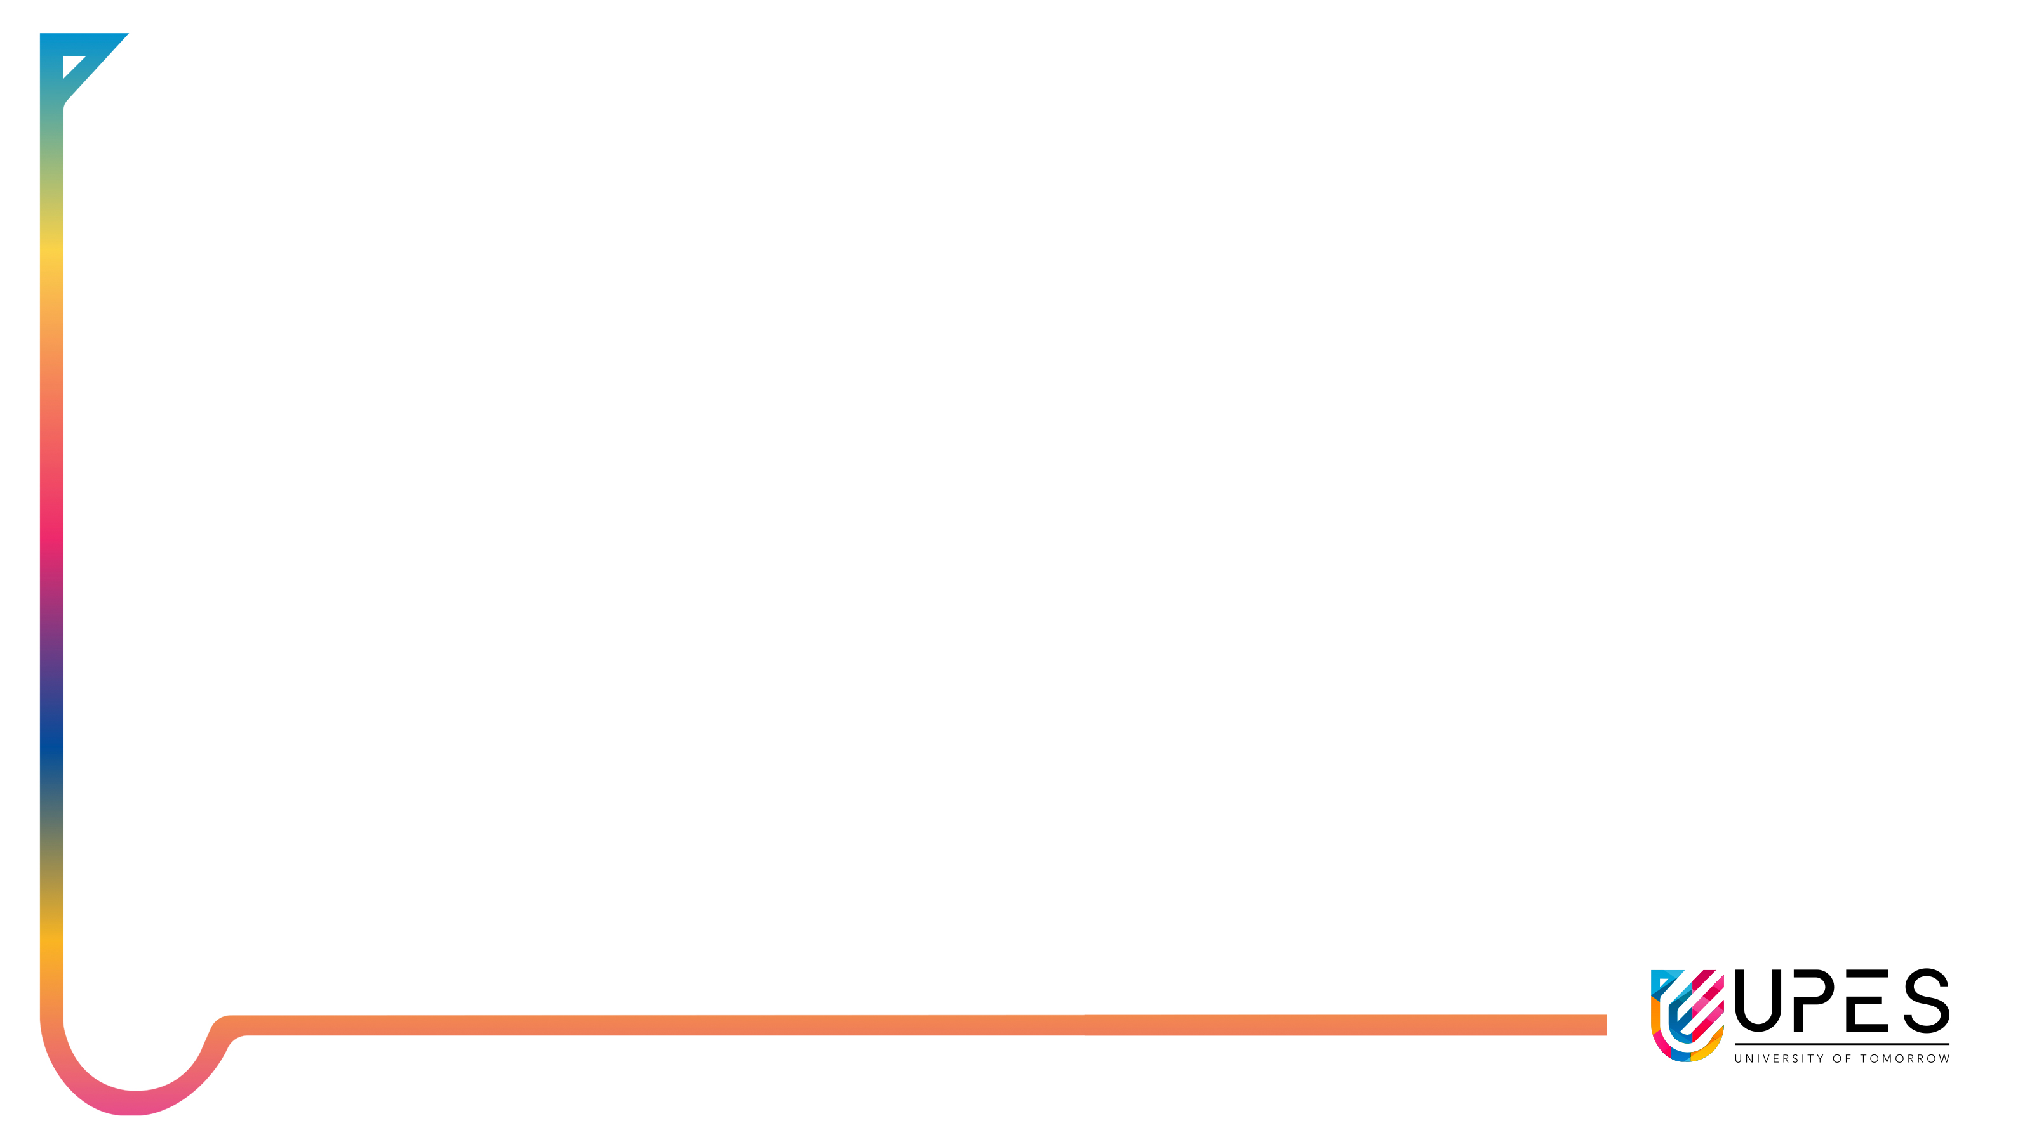
Unit 1 : Introduction to Operating System
Lecture 4
Dr. Hemant Petwal
School of Computer Science UPES, Dehradun
India

Slide 3
Table of Contents
Virtualization and Containerization
Operating System Structures

Slide 4
Learning & Course Outcomes
Learning Outcomes
LO1: Understand the concept of virtualization and Containerization in Operating System
LO2: Understand Operating system structures
Course Outcomes
CO1: Demonstrate a comprehensive understanding of operating systems

Slide 5
Virtualization and Containerization
Virtualization
Virtualization is the process of creating a virtual version of a physical machine or resource, such as a computer, server, storage device, or network. It allows multiple virtual instances to run on a single physical system, enabling better resource utilization, flexibility, and isolation
In other words:
Virtualization in operating systems (OS) is a technology that creates a virtual version of a computing resource, such as hardware platforms, storage devices, or network resources. It enables the creation of multiple simulated environments or dedicated resources from a single physical hardware system.

Slide 6
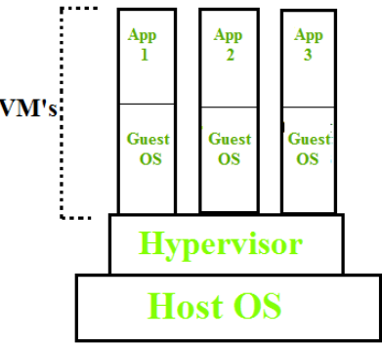
Virtualization: Key Concepts
1. Virtual Machines (VMs)
A virtual machine is an emulation of a computer system. Each VM runs its own operating system and applications, functioning as if it were a separate physical machine.
2. Hypervisor
The hypervisor, also known as a virtual machine monitor (VMM), is the software layer that enables virtualization. It manages the hardware resources and ensures that VMs are isolated from each other while sharing the same physical hardware.
Fig 1. Virtualization
There are two types of hypervisors:
Type 1 (Bare-metal): Runs directly on the physical hardware (e.g., VMware ESXi, Microsoft Hyper-V).
Type 2 (Hosted): Runs on top of a host operating system (e.g., VMware Workstation, Oracle VM VirtualBox).

Slide 7
Virtualization: Key Concepts
Isolation
Virtualization provides strong isolation between VMs. Each VM operates independently and securely, ensuring that issues in one VM do not affect others.
Resource Management
Virtualization allows for efficient resource allocation and management. Resources such as CPU, memory, and storage can be dynamically allocated to different VMs based on demand.

Slide 8
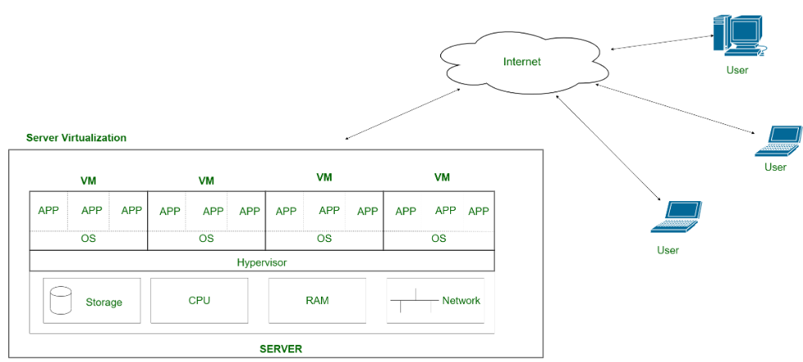
Virtualization: Types
It Divides a physical server into multiple virtual servers, each running its own operating system and applications.
Server Virtualization
Fig 2. Server Virtualization

Slide 9
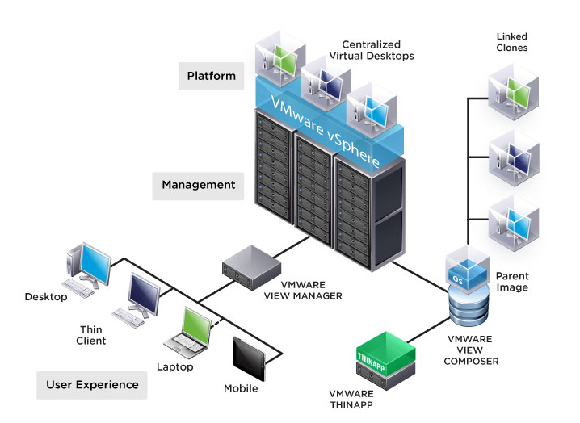
Virtualization: Types
Desktop Virtualization
It Provides virtual desktops to end-users, which they can access from various devices. Examples include Virtual Desktop Infrastructure (VDI) solutions.
Fig 3. Desktop Virtualization

Slide 10
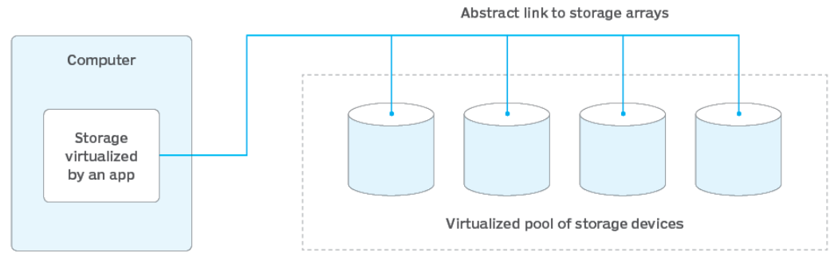
Virtualization: Types
Storage Virtualization
It Abstracts physical storage resources to create a single storage pool that can be managed and allocated efficiently.
Fig 4. Storage Virtualization

Slide 11
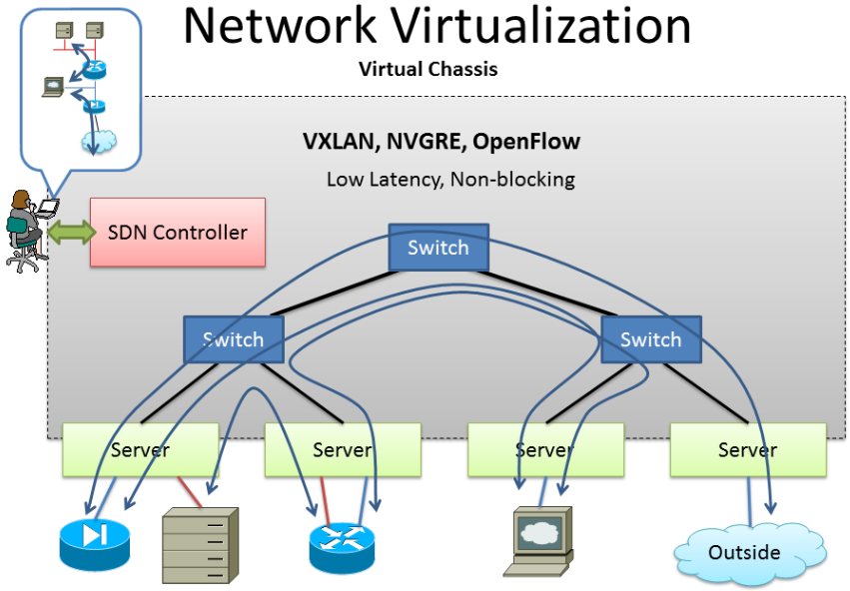
Virtualization: Types
Network Virtualization
It Combines hardware and software network resources into a single, software-based administrative entity.
Fig 5. Network Virtualization

Slide 12
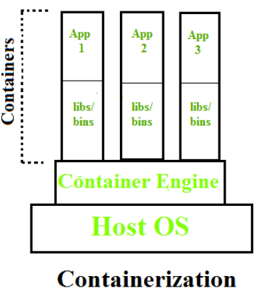
Containerization
Containerization
Containerization in operating systems (OS) involves encapsulating an application and its dependencies into a container, ensuring it runs consistently across different environments.
Containerization was introduced to address certain limitations and inefficiencies associated with traditional virtualization. While virtualization provided significant benefits over physical hardware by allowing multiple operating systems to run on a single physical machine, containerization introduced a more efficient and streamlined approach to application deployment and management
Fig 6. Containerization

Slide 13
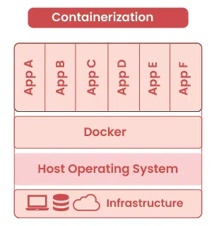
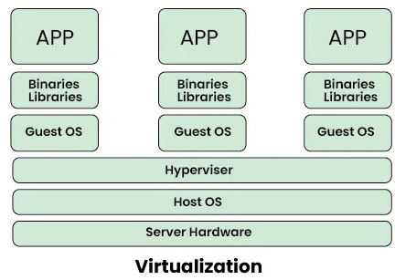
Virtualization vs Containerization
VS
Fig 7. Architectural Difference between Virtualization and Containerization

Slide 14
Virtualization vs Containerization
Feature | Virtualization | Containerization
Isolation | Each VM runs its own OS, providing strong isolation from the host and other VMs. | Containers share the host OS kernel, providing lightweight isolation, but not as strong as VMs.
Resource Usage | VMs require a separate OS instance and consume more resources (CPU, memory, storage). | Containers share the host OS kernel, resulting in more efficient resource utilization.
Performance | Slightly slower performance due to overhead of hypervisor and separate OS instances. | Generally faster performance due to less overhead, as containers leverage the host OS directly.
Portability | VMs can be migrated between different hypervisors and platforms, but with some effort. | Containers are highly portable and can run consistently across different environments (development, testing, production).
Scalability | Scalability is limited by the available resources on the host machine. | Highly scalable as containers are lightweight and can be spun up or down quickly to match demand.
Overhead | Higher overhead due to running multiple OS instances. | Lower overhead as containers share the host OS kernel.
Examples | VMware, VirtualBox, Hyper-V. | Docker, Podman.

Slide 15
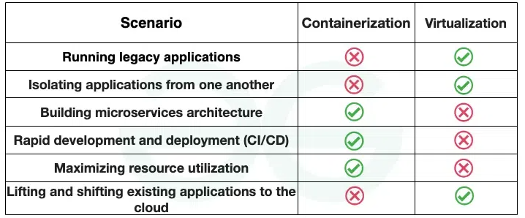
Virtualization vs Containerization
Best Scenarios for Virtualization and Containerization
Fig 8. Scenarios for Containerization and Virtualization

Slide 16
Operating System Structures
The operating system can be implemented with the help of various structures.
The structure of the OS depends mainly on how the various standard components of the operating system are interconnected and melded into the kernel.
A design known as an operating system enables user application programs to communicate with the machine’s hardware.
Types of structures in Operating systems
Simple/Monolithic Structure
Micro-Kernel Structure
Hybrid-Kernel Structure
Exo-Kernel Structure
Layered Structure
Client Server Model
Virtual Machines

Slide 17
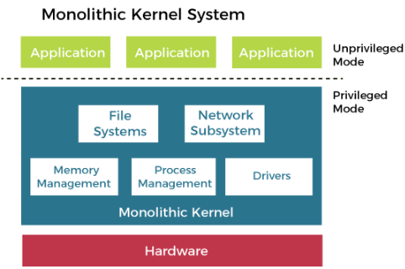
Operating System Structures: Types
Simple/Monolithic Structure
A unified operating system architecture where the kernel provides all essential services directly to user applications
Fig 9. Simple/Monolithic OS Structure

Slide 18
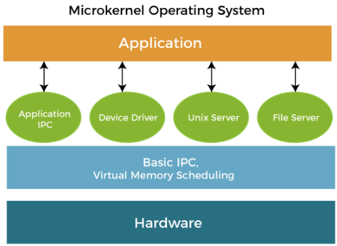
Operating System Structures: Types
Micro-Kernel Structure
A minimalistic operating system architecture where the kernel provides only essential services, and additional functionalities are implemented as user-space processes.
Fig 10. Micro-Kernal Structure

Slide 19
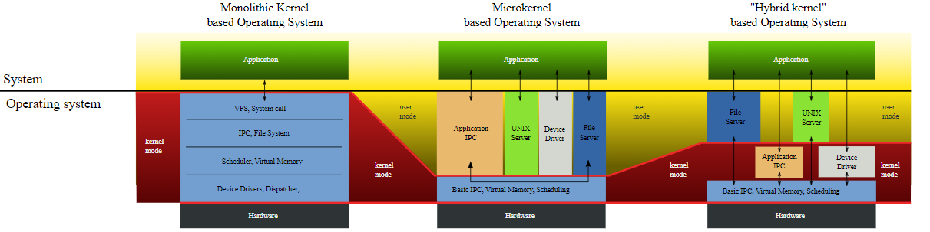
Operating System Structures: Types
Hybrid-Kernel
Structure
An operating system architecture combining aspects of both monolithic and microkernel designs, offering a balance between performance and flexibility.
Fig 11. Hybrid-Kernal Structure

Slide 20
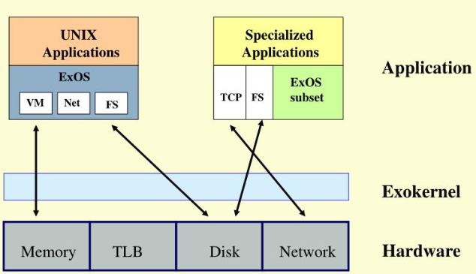
Operating System Structures: Types
Exo-Kernel Structure
An operating system architecture that exposes hardware resources directly to applications, allowing greater flexibility but requiring applications to manage resources explicitly.
Fig 12. Exo-Kernal Structure

Slide 21
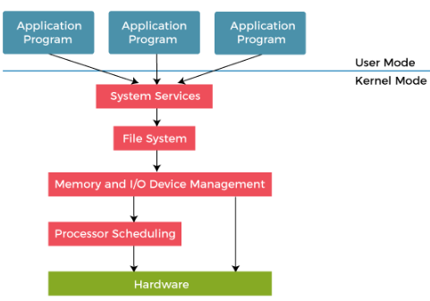
Operating System Structures: Types
Layered Structure
An operating system structure organized into layers, with each layer providing a set of services to the layer above, facilitating modular design and ease of maintenance.
Fig 13. Layered Structure

Slide 22
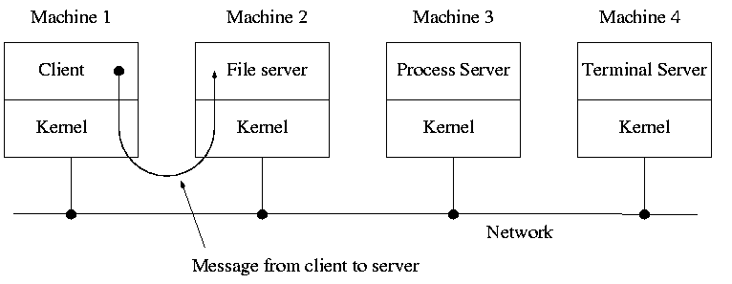
Operating System Structures: Types
Client-Server Model
An operating system structure where services are divided into client and server components, with servers providing specific functionalities to client applications upon request.
Fig 14. Client-Server Structure

Slide 23
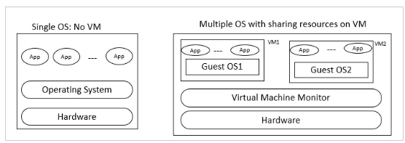
Operating System Structures: Types
Virtual Machines
A layer of software that enables multiple operating systems to run concurrently on the same hardware by virtualizing resources and providing isolation between guest operating systems.
Fig 15. Virtual Machine Structure

Slide 24
MCQ
Q1. What role does the hypervisor play in virtualization?
A. Managing network connections B. Controlling user access
C. Enabling and managing virtual machines D. Monitoring internet traffic
Q2. Which type of hypervisor runs directly on the physical hardware?
A. Type 1 (Bare-metal) B. Type 2 (Hosted)
C. Type 3 (Network-based) D. Type 4 (Cloud-based)
Q3. What is the primary purpose of server virtualization?
A. Divide a physical server into multiple B. To provide virtual desktops to end-users
virtual servers
C. To abstract physical storage resources D. To combine hardware software network resources
Q4. Which offers better performance due to less overhead?
A. Virtualization B. Containerization
C. Both have equal performance D. Depends on the hardware

Slide 25
MCQ
Q5. What is containerization in operating systems?
A. Creating virtual networks B. Encapsulating an application and dependencies into a container
C. Dividing physical storage into virtual pools D. Combining multiple virtual machines into one
Q6. Which has higher overhead due to running multiple OS instances?
A. Virtualization B. Containerization
C. Both have equal overhead D. Neither has overhead
Q7. What does the structure of an operating system depend on?
A. The type of applications it runs B. How its components are interconnected and integrated into the kernel
C. The speed of the underlying hardware D. The number of users it supports

Slide 26
MCQ
Question No-Answer | Option | Description
Q1- Answer | C | Enabling and managing virtual machines
Q2- Answer | A | Type 1 (Bare-metal)
Q3- Answer | A | Divide a physical server into multiple virtual servers
Q4- Answer | B | Containerization
Q5- Answer | B | Encapsulating an application and dependencies into a container
Q6- Answer | A | Virtualization
Q7- Answer | B | How its components are interconnected and integrated into the kernel

Slide 27
Summary/Key Points
Virtualization is the process of creating a virtual version of a physical machine or resource, such as a computer, server, storage device, or network.
The major components associated with virtualization are virtual machines and hypervisor
Hypervisor is of two types: Type 1 (Bare-Metal hypervisor), Type 2 (Hosted hypervisor)
Virtualization is categorized into following categories (types): Sever, Desktop, Network, Storage virtualization
Containerization was introduced to address certain limitations and inefficiencies associated with traditional virtualization
The operating system can be implemented with the help of various structures e.g. Simple/Monolithic Structure, Micro-Kernel Structure, Hybrid-Kernel Structure, Exo-Kernel Structure, Layered Structure, Client-Server Model, Virtual Machines

Slide 28
Reference Material
Operating Systems Concepts (10th Ed.) Silberschatz A, Peterson J and Galvin P, John Wiley & Sons, Inc. 2018.
Topics:
Virtualization and Containerization, Page No: 34
Operating System Structures, Page No: 81-91
Modern Operating Systems (4th Ed.) by Andrew S. Tanenbaum and Herbert Bos, 2007
Operating Systems: Principles and Practice by Thomas Anderson and Michael Dahlin, 2014

Slide 29
Coming Up-Next Lecture
Various operations of Operating System

Slide 30

Thank You

